Slide 1
Intro to Unity 2D
Chris Martone
Steve Maier
http://42base13.net/

Slide 2

We will be breaking to see this ☺

Slide 3
Agenda
Download your tools
Intro to Unity, 2D and the Editor
Assets, Cameras and Sprites (break)
Physics 2D, Prefabs and Object Hierarchies
Animations and Code (break)
Particle Systems and GUIs
Building and Testing on Windows (break)
Open workshop till time up.

Slide 4
Download and install your tools!
Unity (latest version)
Visual Studio
The Sprites and Scripts

Slide 5
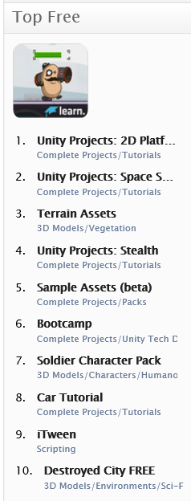
What is Unity?
Game Engine
Integrated Development Environment
Extensible
A Store (with free assets too!)
Pretty much just awesome

Slide 6
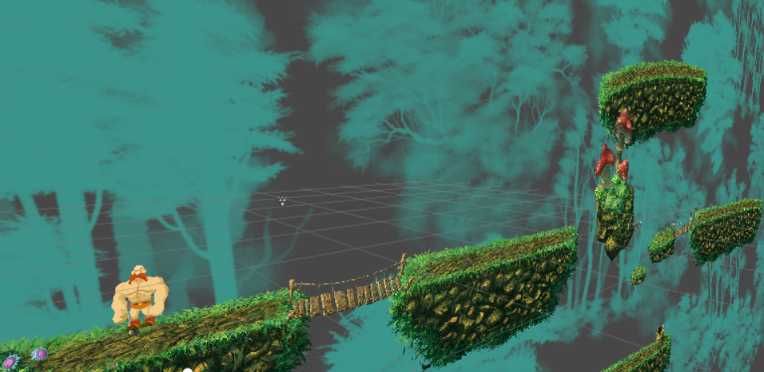
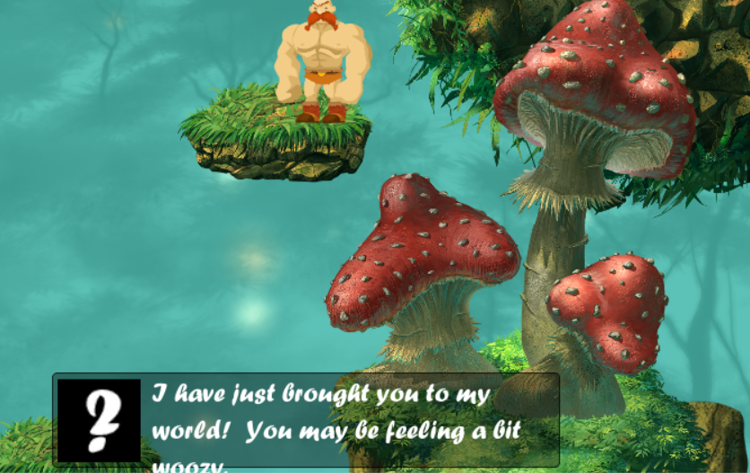
2D Overview
2D is 3D, except the camera always looks straight on moving only in the x and y axis.
3D Objects can still be in 2D Games!
Collider 2D (instead of Collider)
Physics 2D (instead of Physics)
Sprite Renderer
Sorting Layers (Are Great)
Mechanim for sprite(sheets)
Game Objects
Scripting!

Slide 7
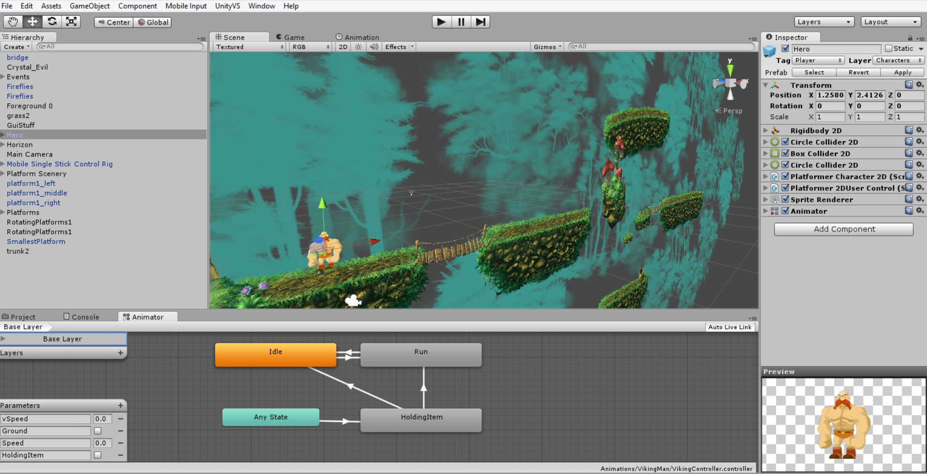
The Editor
The various windows
Extensible
Ties into visual studio
Customize your layout
ASSET STORE!

Slide 8

Editor and 2D - Demo

Slide 9
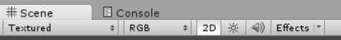
Create a New Project
File -> New Project
Name it AwesomeSauceGame (or similiar)
Set up the Editor how you want.
Set the Scene Window to 2D

Slide 10
Prepare your workspace
Create the following folders:
Prefabs
Scripts
Sprites
Animation
Scenes
Copy the sprites from the content into the sprites folder.
Copy the scripts from the content into the scripts folder.

Slide 11
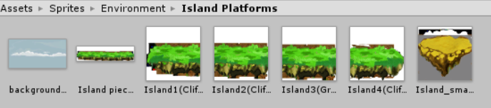
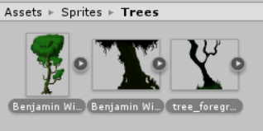
Slice up Some Sprites!
Start with your scenery
Show doing individual
Show doing batch
Talk about max size

Slide 12
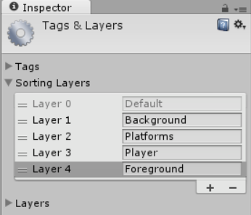
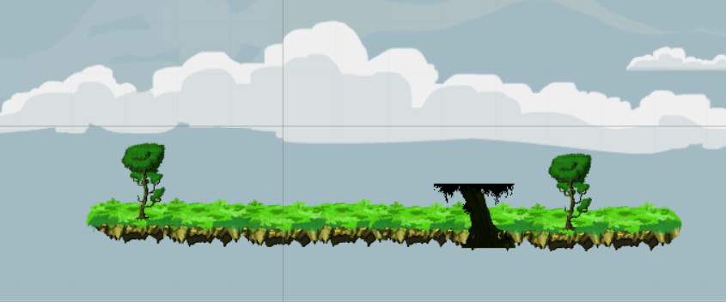
Drop a few sprites on the scene
Talk about sorting layers

Slide 13
Saving your work
Click Save.
Save to the Scenes Folder. Name the Scene Game Scene

Slide 14
Cameras
Click on Game Window…
Talk about Orthographic vs Perspective
Talk about Z ordering (but its 2D?!?!?) -> why I like Perspective.

Slide 15
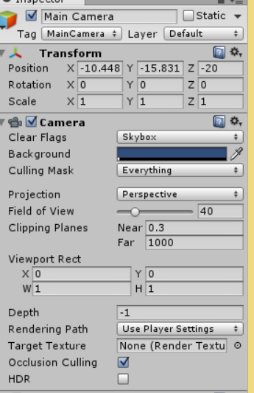
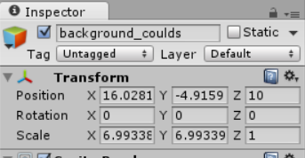
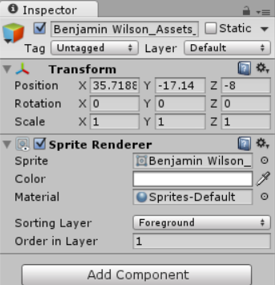
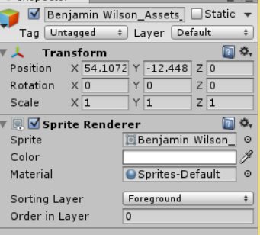
Spend Some Time Getting it set Up

Slide 16
Break – 10 minutes

Slide 17
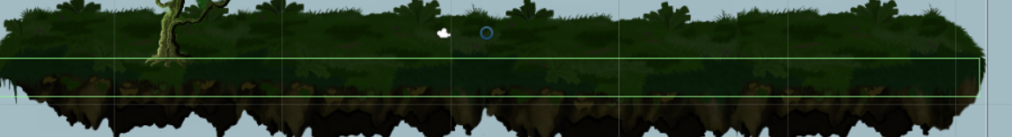
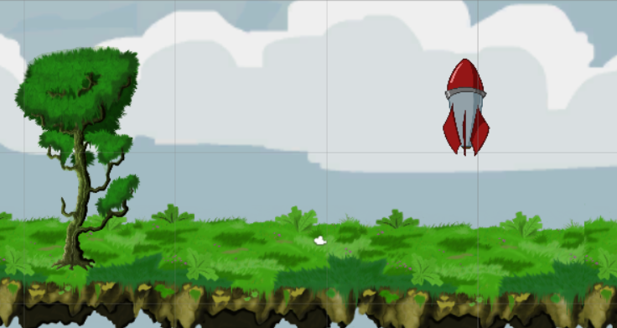
Physics 2D – Colliders and rigidBodies
Add a box collider to the Platform
Add the Rocket to the scene, rotate around z by 90 degrees
-Add a box collider and rigid body to the rocket
-Have the rocket set a bit higher than the platform.

Slide 18
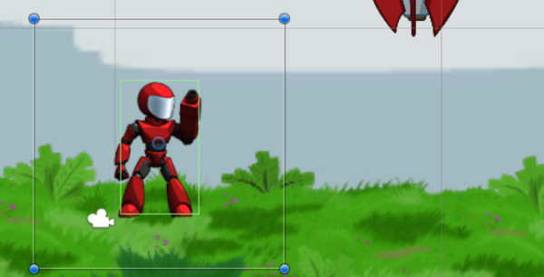
Add the Character
Slice up the standing Sprites
Drop one on the scene
Add a box collider and rigid body

Slide 19
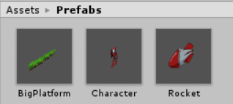
Prefabs
Open the project window Right Click -> New Prefab

Slide 20
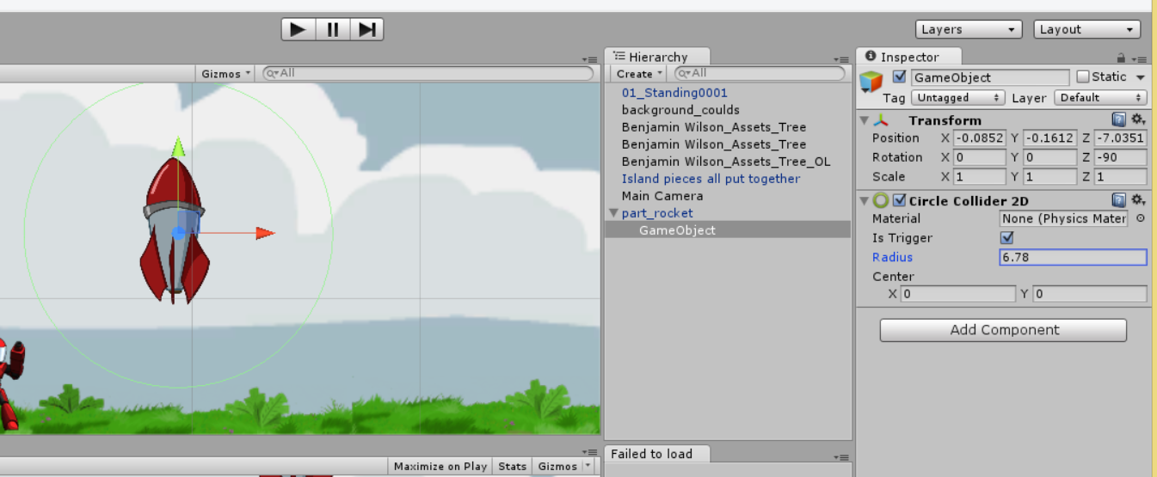
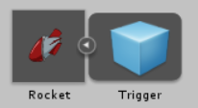
Object Hierarchies
Create an empty game object
Drag it onto the rocket.
Add a circle collider to the game object
Set the collider as a trigger
Talk about hierarchies
and how they are useful.
-Movement
-Organization
-Independent Interactions
Drag the rocket back onto the rocket prefab to save your work on this prefab.

Slide 21
Some time for audience to get everything
Q&A?

Slide 22
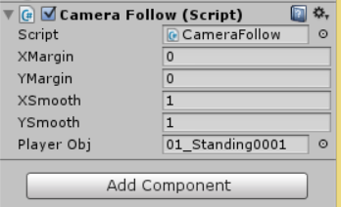
Add Code to a Game Object
Drag the CameraFollow Script and drop it onto the Main Camera
Find your character in the hierarchy and drop him onto the Player Obj property.

Slide 23
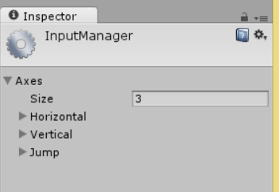
Set Up Input
Edit -> Project Settings -> Input
Scale it back to 3 inputs
left, right, up, down, space

Slide 24
Move your Character!
Talk about
Public variables (and the editor)
Caching components.
Update vs Fixed Update
Awake vs Start
Jumping and Moving the Character
Notes:
using UnityEngine;
using System.Collections;
public class CharacterScript : MonoBehaviour {
public float MaxSpeed = 10.0f;
public float JumpForce = 1200.0f;
//cached version of our rigidbody
private Rigidbody2D cachedBody = null;
//first initialization phase
private void Awake()
{
this.cachedBody = this.GetComponent<Rigidbody2D>();
}
// 2nd initialization phase
private void Start ()
{
}
// Update is called once per frame
private void Update ()
{
if (Input.GetButtonDown("Jump"))
{
this.rigidbody2D.AddForce(new Vector2(0, this.JumpForce));
}
}
//Fixed update is used to keep in sync with physics
private void FixedUpdate()
{
float xSpeed = Input.GetAxis("Horizontal");
Vector2 newVelocity = new Vector2(xSpeed * this.MaxSpeed, this.rigidbody2D.velocity.y);
this.rigidbody2D.velocity = newVelocity;
}
}

Slide 25
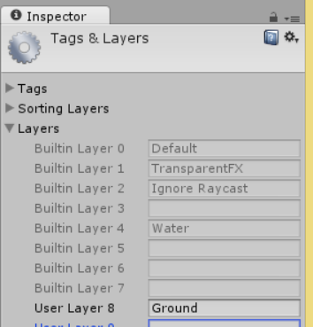
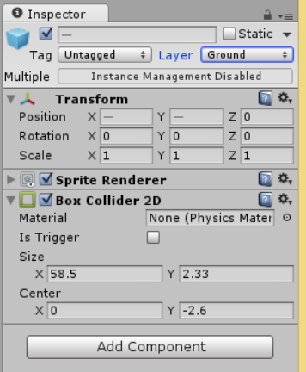
I can jump infinitely!?
Create a new Game Object (GroundChecker) add to player
Talk about finding objects in the hierarchy
Talk about Layer Masks
Add Ground && set the platforms to ground
http://answers.unity3d.com/questions/8715/how-do-i-use-layermasks.html
Bit shifting for which layers to check.
Create Script Ground Checker
Modify Character Script
Notes:
-----------------------------------------------------------------------------------groundchecker
using UnityEngine;
using System.Collections;
public class GroundChecker : MonoBehaviour {
public float checkRadius = .65f;
private bool grounded = false;
// Use this for initialization
void Start () {
}
// Update is called once per frame
private void Update () {
Vector2 posV2 = new Vector2(this.transform.position.x, this.transform.position.y);
this.grounded = Physics2D.OverlapCircle(posV2, this.checkRadius, 1 << this.gameObject.layer);
}
public bool IsGrounded()
{
return this.grounded;
}
}
----------------------------------------end ground checker
----------------------------------------start player
using UnityEngine;
using System.Collections;
public class CharacterScript : MonoBehaviour {
public float MaxSpeed = 10.0f;
public float JumpForce = 1200.0f;
//groundCheckObject
private GroundChecker groundCheckScript;
//cached version of our rigidbody
private Rigidbody2D cachedBody = null;
//first initialization phase
private void Awake()
{
this.cachedBody = this.GetComponent<Rigidbody2D>();
}
// 2nd initialization phase
private void Start ()
{
this.groundCheckScript = GameObject.Find("Player/GroundCheck").GetComponent<GroundChecker>();
}
// Update is called once per frame
private void Update ()
{
if (Input.GetButtonDown("Jump")
&& this.groundCheckScript.IsGrounded())
{
this.rigidbody2D.AddForce(new Vector2(0, this.JumpForce));
}
}
//Fixed update is used to keep in sync with physics
private void FixedUpdate()
{
float xSpeed = Input.GetAxis("Horizontal");
Vector2 newVelocity = new Vector2(xSpeed * this.MaxSpeed, this.rigidbody2D.velocity.y);
this.rigidbody2D.velocity = newVelocity;
}
}
--------------------------------------------------------------end player

Slide 26
Mechanim
Add component->other->Animator
Create an animatorcontroller
Assign to the character
Highlight all, drop sprites on it
Create the idle animation
Create the run animation
Wire them up
Add parameters to mechanim
Show transitions
Fix facing direction
Notes:
using UnityEngine;
using System.Collections;
public class CharacterScript : MonoBehaviour {
public float MaxSpeed = 10.0f;
public float JumpForce = 1200.0f;
//is facing right
private bool isFacingRight = true;
//groundCheckObject
private GroundChecker groundCheckScript;
//cached version of our rigidbody
private Rigidbody2D cachedBody = null;
//cached version of the animator
private Animator cachedAnimator = null;
//first initialization phase
private void Awake()
{
this.cachedBody = this.GetComponent<Rigidbody2D>();
this.cachedAnimator = this.GetComponent<Animator>();
}
// 2nd initialization phase
private void Start ()
{
this.groundCheckScript = GameObject.Find("Player/GroundCheck").GetComponent<GroundChecker>();
}
// Update is called once per frame
private void Update ()
{
if (Input.GetButtonDown("Jump")
&& this.groundCheckScript.IsGrounded())
{
this.rigidbody2D.AddForce(new Vector2(0, this.JumpForce));
}
}
//Fixed update is used to keep in sync with physics
private void FixedUpdate()
{
float xSpeed = Input.GetAxis("Horizontal");
Vector2 newVelocity = new Vector2(xSpeed * this.MaxSpeed, this.rigidbody2D.velocity.y);
this.rigidbody2D.velocity = newVelocity;
this.cachedAnimator.SetFloat("Speed", Mathf.Abs(newVelocity.x));
if(newVelocity.x > 0
&& !this.isFacingRight)
{
this.FlipFacing();
}else if(newVelocity.x < 0
&& this.isFacingRight)
{
this.FlipFacing();
}
}
private void FlipFacing()
{
this.isFacingRight = !this.isFacingRight;
this.transform.localScale = new Vector3(this.transform.localScale.x * -1, this.transform.localScale.y, this.transform.localScale.z);
}
}

Slide 27
Particle System
Walk through creating a particle system
Walk through importing a sprite to use
Add the particle system to the rocket
Show turning objects on and off from code

Slide 28
Trigger 2D – particle system On
When the player enters the rocket’s trigger, have it turn on the particle system

Slide 29
GUI
Walk through NGUI
Create a Title Scene w/a Title, a Play Button and text describing controls
When push the button, start the game.

Slide 30
HUD
Show NGUI and interaction.
When player hasn’t launched the rocket, label that says “Launch the Rocket!”
When player launches the rocket, label changes to say “Rocket Launched!”
Wait a few seconds, and switch back to title scene.

